Slide 1



Slide 2
Highlights of IPAC National Conference
2016

Slide 3
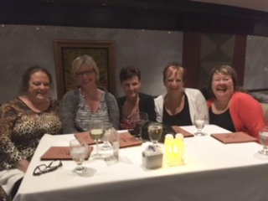
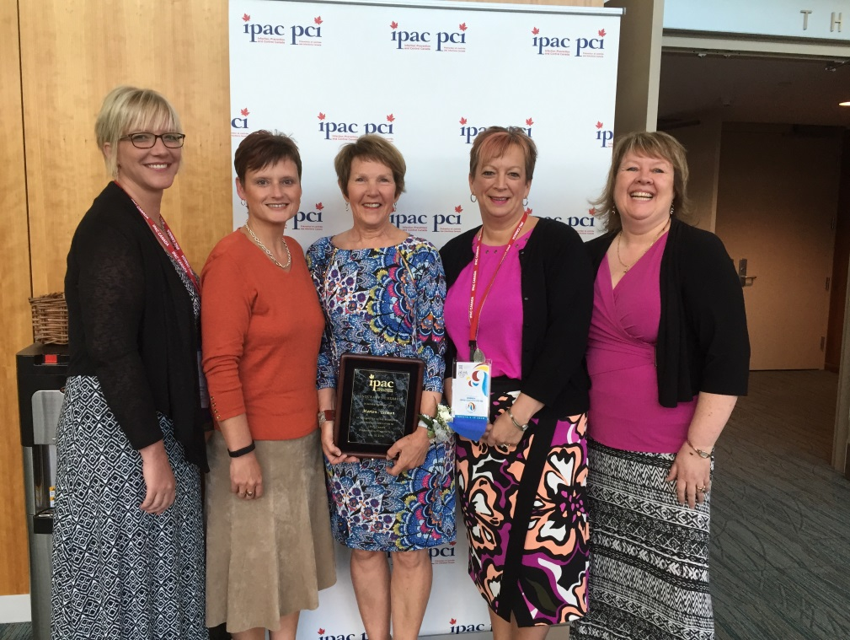

IPAC NL Representation

Slide 4



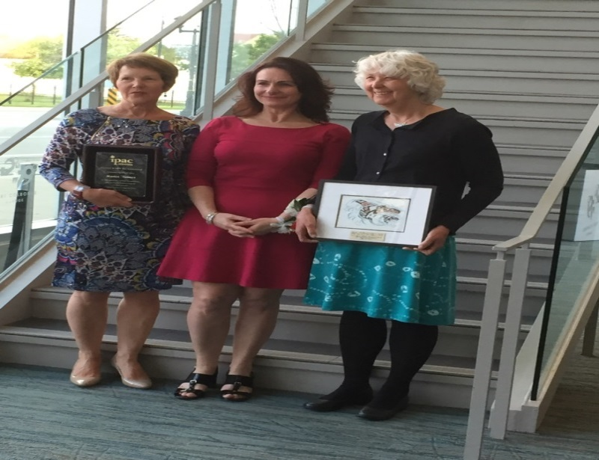
Newfoundland and Labrador Honorary Member IPAC Canada
Marion Yetman

Slide 5
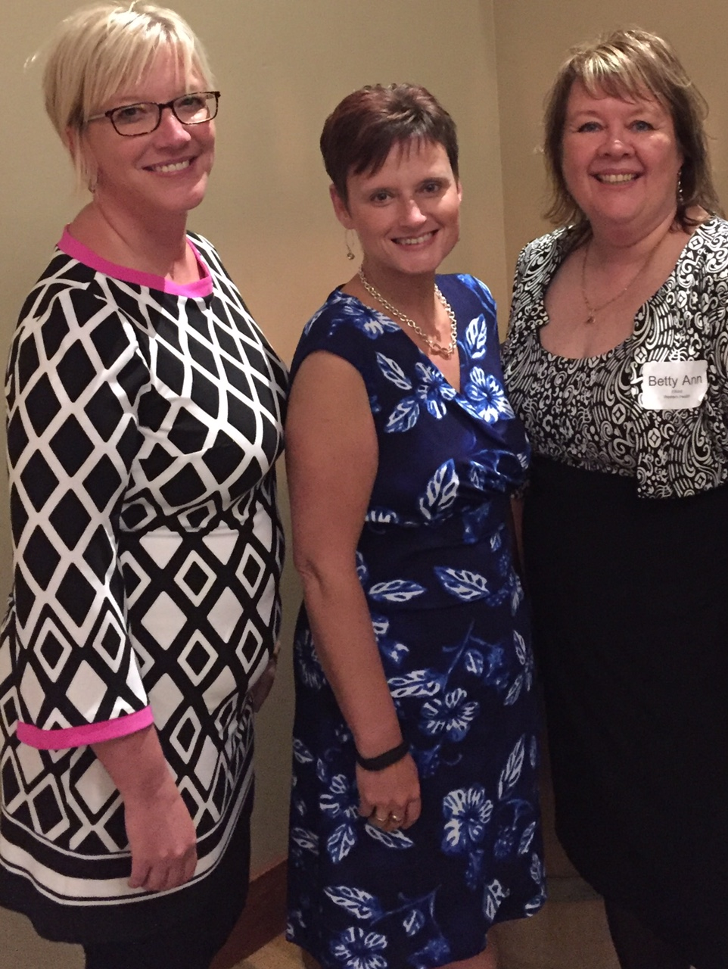
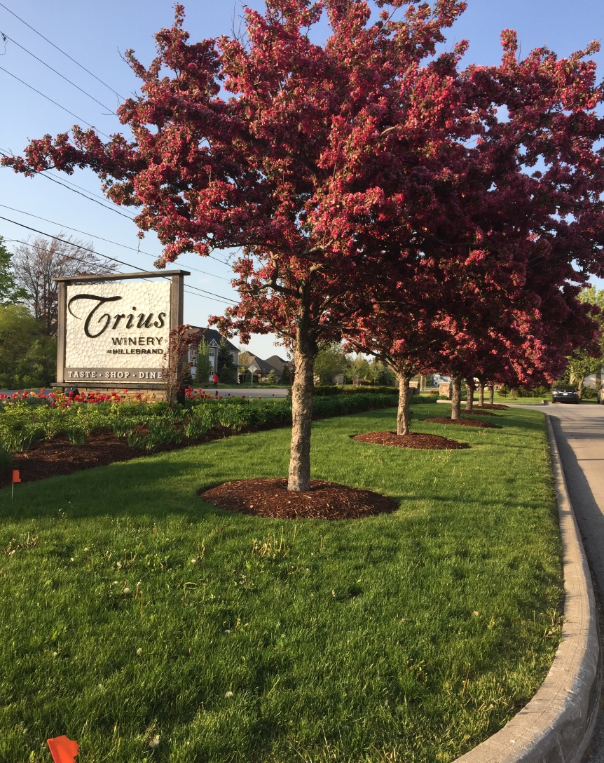
Sealed Air Diversey Scholarship 2016 recipients

Slide 6
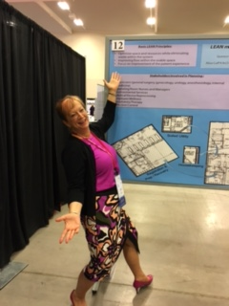
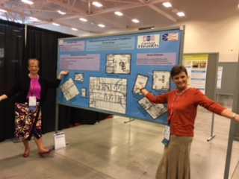
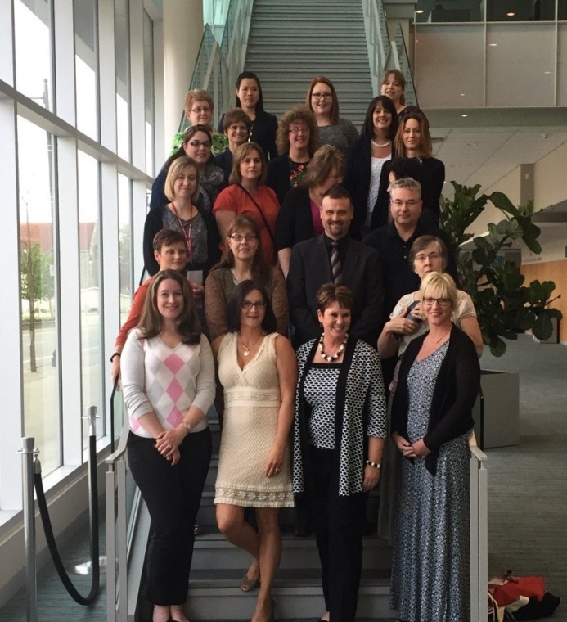
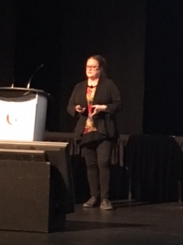
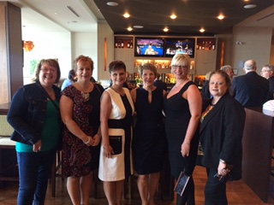

Slide 7


Sightseeing

Slide 8





Slide 9


Slide 10
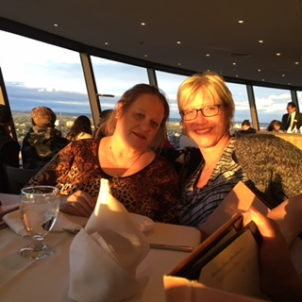
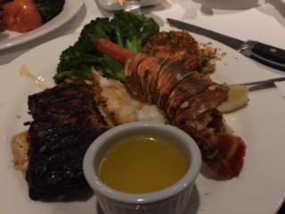


Slide 11


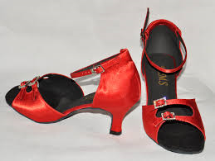
Gala Event
Elements on the Falls Restaurant
Put on Your Ruby Dancing Shoes
IPAC 40th Anniversary Celebrations!!

Slide 12

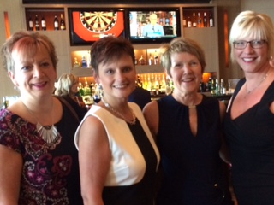


Slide 13





Slide 14

Favorite Sessions

Slide 15
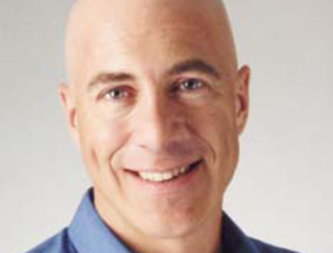
Gregg Brown
Don’t Let An Outbreak Become a Breakdown!
Gregg Brown is a captivating speaker and expert in the fields of leadership and change. Gregg began his career teaching life skills to one of the most difficult groups of people to change: hard core prisoners. He transitioned into leading education and organizational change initiatives in large healthcare organizations, as well as consulting with leaders and executives on
individual behavior change.

Slide 16
How to deal and cope with change effectively
Coping strategies
How healthcare is under great pressures, emphasizing how important it is for us as leaders to have control and to help staff become resilient
These days, people find it extremely challenging to keep up with change in their organizations given the relentless pressure to do more – faster, better and with less!
How to acquire the critical mindsets and techniques needed to deal with multiple changes even in times of uncertainty!
The impact of changes can sidetrack you, your colleagues, stall your organization and even allow mistakes to happen.

Slide 17



Didier Pittet
Clean Hands Save Lives/ Adapt To Adopt
Is a Professor of Medicine, the Hospital Epidemiologist and Director of the Infection Control Programme and World Health Organization (WHO) Collaborating Centre on Patient Safety at the University of Geneva Hospitals and Faculty of Medicine, Geneva, Switzerland.

Slide 18
Is an advocate for health.
He has become the voice for a cleaner and safer medical facilities around the world.
He has proven that simple acts of hand hygiene can have immense impact on the health.
In 2004, Pittet was approached by the WHO World Alliance of Patient Safety to lead the First Global Patient Safety Challenge under the banner "Clean Care is Safer Care"
Together with a multimodal improvement strategy, based on the successful model developed in Geneva and published in The Lancet in 2000.
Which led to the creation of a “multimodal strategy” based on education, performance monitoring and feedback, and culture change.
The key component: introduction of alcohol-based hand rub at the point of care to replace handwashing at the sink.
As of December 2014, "Clean Care is Safer Care" has been endorsed by ministers of health in over 130 countries worldwide representing a coverage of more than
95% of the world population! Now it is in 180 countries!
Go to You Tube and watch: “Adapt to Adopt” Didier Pittet, www.tinyurl.com/adapttoadopt and www.hhea.com
Notes:
In the United States at least 200,000 patients die of HCA infections every year. The equivalent of a 747 airliner crashing everyday!
Change behaviour is not easy; resistance to change !
Adapt to Adopt is his motto! Let people be creative, creativity is key!
Clean Hands Save Lives!

Slide 19
Network of Networks
Interest group was established in May 2009
Philosophy : IPAC Canada members working in regional ,provincial ,territorial or federal leadership positions have unique needs for networking , education and information sharing
Chair: Gwen Cerkowniak ( Saskatchewan) e:gwen.cerkowniak@saskatoonhealthregion.ca
Co Chair: Vacant
Purpose : to develop and support a sustainable mechanism for communication, develop and maintain a network of sharing information, ideas and solutions to issues/problems, support research and promote partnerships with stakeholders across the continuum of care
Structure : All Interest Group members must be members of IPAC Canada, report through the Board of Director and Executive Director of IPAC Canada Board, 2 co chairs, Term of office 2 years
To become a member of an interest group please go to membership page for further information or email admin@ipac-canada.org
Notes:
These purposes are not all inclusive – See notes. The structure also includes sub committee as required . The 2 co chairs will be from different geographical areas of the country . The term is 2 years with appointments alternating by year to ensure continuity.A member is also assigned responsibility for encouraging members to make submissions to The Canadian Journal of Infection Control. And a recording secretary is appointed to record the minutes at all meetings. Interest group meeting will be held at the National Conference and a minumum of 1 meeting held each year by teleconference. They had webinar in Feb 2016, April 2016 and then face to face at National Conference in May 2016 This years confernece discussions included position staement for CIC CBIC certification, IPAC Canada Mentoring program.

Slide 20
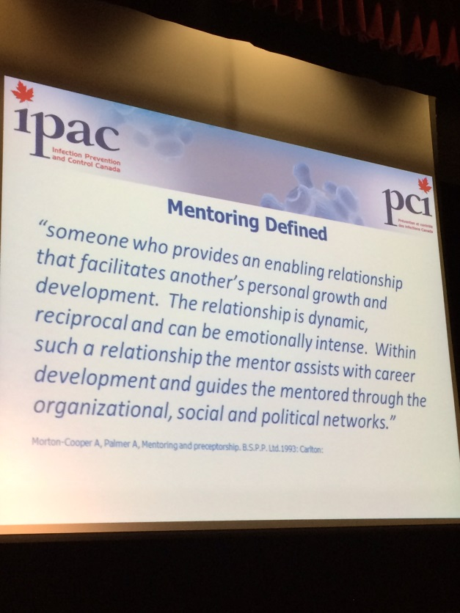
Mentoring Program
Notes:
The Mentoring program was a topic of discussion at the Network of Network meetings, Mentoring is defined as……..It promotes career development, supports the ICP’s by facilitating the transfer of knowledge and skill development. This program provides a culture of ongoing learning and helps to bridge the gap from novice to expert. There is an application process and the IPAC Canada coordinator will pair the mentor and mentee. IPAC Canada had an introductory webinar earlier this summer and plans to implement the program in the fall.

Slide 21
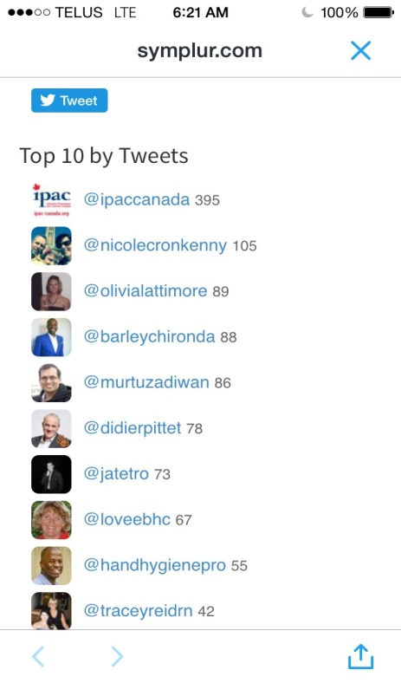



Twitter™/Linked In™
Top 10 Tweets #ipac2016
#highfive
Notes:
At the IPAC Canada 2016 conference I used the Twitter network to brand myself as a novice ICP eager for knowledge. I sent out regular ‘tweets’ and I was able to follow along with what was happening at the conference. Here is our Keynote speaker Didier Pitet posing for a #high five moment. This tweet was liked , shared and retweeted many times throughout the conference. This one tweet connected me to many novice and expert ICPs as well as people in the industry.
Twitter and Linked in are two social media platforms that are effective in building networks with peers and colleagues. It provides access to thought leadership, research and current trends. Linked In in particular is the leading professional network that allows you to connect with professionals in IPAC, to join groups of interest and to do job searches. Barley Chironda is the IPAC Canada Social Media guru who will be presenting on Social Media on Sept 28 for our annual conference.

Slide 22

Social Media
Barley Chironda, IPAC Canada Social Media Manager
Barley Chironda is IPAC Canada’s Social Media Manager and is the current President of IPAC- GTA. He is also the Business Development and Infection Control Specialist with Clorox Canada. He is certified in Infection prevention and control (CIC®) and has worked extensively in Infection Control. He is typically found engaged in motivating hospital staff, patients and the public on proper infection prevention practices. He takes pride in sharing information via social media and is often engaging the public on Twitter™ and LinkedIn™, partaking in resource distribution related to innovative and novel infection prevention strategies.
www.ipac-canada.org
Notes:
Barley will be able to enlighten our group on social media, its benefits and how to get started in networking with colleagues and peers. I look forward to hearing his presentation.

Slide 23
Long Term Care Interest Group
Chair: Adeline Griffin
Co-chair: Cathy Guitare
Discussion/Update on National Surveillance Case Definitions Standardization Project LTC Group
The need of a new co-chair
Thoughts on creation of a position statement
Networking
Presentation on: Surveillance for C. difficile Infection (CDI) in Alberta Continuing Care Facilities
Notes:
1. There will be an e-mail sent out to the group for any interested person from LTC.
2. There is a continuing care resource manual A-Z one pager and it is called “AHS Continuing Care Resource Manuel.(risk assessment for isolation precautions, interventions, cleaning with a sporicidal agent and dedicate equipment)
3. Strain Virulence elderly host may be severe outcomes, they discussed NAP 1 “Quebec Strain” doubles usual level toxin production – death related to CDI
4. Talked about waning immune response in the elderly(Inability of host to mount sufficient IgG response. The elderly can have asymptomatic colonization
5. When it came to hand hygiene with soap and water friction was emphasized.

Slide 24
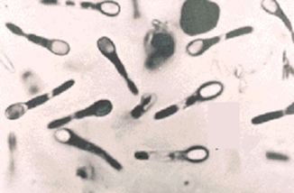
CDI and the Elderly Host
 | Elderly host in CC | C. difficile
Age-related | Exposure to antibiotics; decreased gut acidity; other comorbidities; use of feeding tubes | Anaerobic bacteria, forms spores, produces toxin; decreased acidity may trigger toxin production
Onset | Exposure to antibiotics, protein pump inhibitors | Depletion of gut microbiome diversity; mild diarrhea to potentially fatal colitis
Strain Virulence | May be severe outcomes – death related to CDI; colectomy | NAP 1 “Quebec strain” – doubles usual level toxin production
Lab testing | Stool testing with onset of diarrhea - only once per 7 days | PCR testing for toxin genes - provincial standardization
Environmental contamination | Bed rails, call buttons, bedside tables, phones, vacuum bags | HARDY – spore forms survive routine cleaning disinfectant (quats)
Hand Hygiene | Soap and Water | Alcohol not effective against spores
Treatment | First line treatment - oral metronidazole | 20% relapse with vancomycin; use of probiotics; fecal microbiome transplant
Immunity? | Waning immune response – inability of host to mount sufficient IgG response | Immune response – IgG to Toxin A allows for control of toxin production. Can have asymptomatic colonization.
Notes:
ABX – use ONLY if necessary – risk of treating inappropriately vs risk of acquiring CDI
Cdiff – mild diarrhea to potentially fatal colitis – other Clostridium species (also anaerobic, produce toxin) – C. tetanii, C. perfringens (food poisoning, gangrene), C. botulinum
CDI responsible for up to 25% of all antibiotic-associated diarrhea, most common bacterial cause of diarrhea in healthcare (viral=Noro)
NAP 1 – higher activity Edmonton/North zone – higher rates in acute care than in rest of province

Slide 25

Preparing for the CIC Exam
Make sure you are eligible:
Visit www.cbic.org
90 days to write
3 hour exam; immediate pass or fail
150 multiple choice questions
Passing score 75%
New 8 categories instead of 6

Slide 26
What’s on the Exam
1. Identification of Infectious Disease Processes
2. Surveillance and Epidemiologic Investigation
3. Preventing/Controlling the Transmission of Infectious Agents
4. Employee/Occupational Health
5. Management and Communication
6. Education and Research
7. Environment of Care
8. Cleaning, Sterilization, Disinfection, Asepsis

Slide 27
RESOURCES
The CBIC Handbook
Practice Exam

Slide 28
References for CIC Exam
APIC Text of Infection Control and Epidemiology
Ready Reference of Microbes
Control of Communicable Disease Manuel, 19th edition
The Infection Prevention's Guide to the Lab
Current guidelines, standards and recommendations from CDC, APIC, SHEA, and Public Health agency of Canada

Slide 29
Website
A new look…
New format coming in fall 2016…
Pamela Chalmers will be replacing Shirley MacDonald…
OSM Websites will be reformatting for IPAC Canada…
Change will be complete in September 2016…
Training for Webmasters to follow in the fall 2016…
Recommendations:
Pleasant experience for first time visitors
Appealing look with white space and not too busy with key graphical choices
Easy and familiar access to common areas for chapter members
Search engine optimizes pages to find specific sites without going through homepage

Slide 30
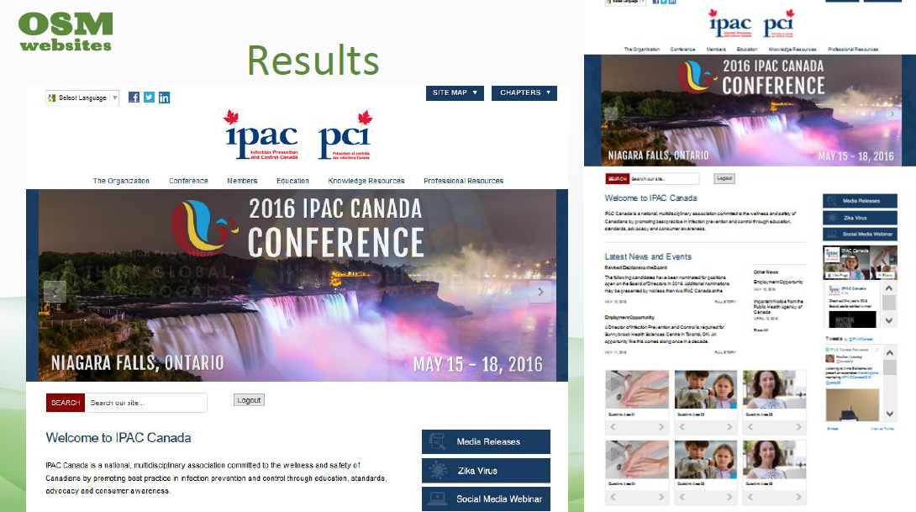

Slide 31



Website
Benefits for Chapter Websites:
Own domain name
Be able to post their own materials
Be secure in one area
Any edits to web page will be passed on to OSM for review
Be able to view number of visitors to page
Business items such as minutes will be accessible to IPAC NL members only
Same layout as IPAC Canada page

Slide 32


Slide 33


